Slide 1
Critical Design Review:
Efficient Solar Panels for Hot Water
Team 21
Stanley Nguyen, Hal Levin, Moises Bensadon
21
Prof Robert Kotiuga

Slide 2
Efficient Solar Panels for Hot Water
21
Prof Robert Kotiuga
Problem statement:
Solar panels are 15-22% efficient in optimal conditions and decrease in efficiency as temperature increases
How can circulated water be used to increase a solar panel’s power production efficiency?
Design and build an efficient, low maintenance solar panel that can be connected to an existing water heating system

Slide 3
Efficient Solar Panels for Hot Water
21
Prof Robert Kotiuga
Functions and Objectives
Monitoring system must record temperature of solar panels and record energy output
Automatically trigger water pump to cool solar panels when temperature exceeds optimal operating temperature
Display energy and cost savings to the user

Slide 4
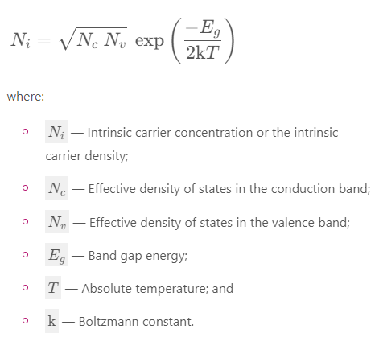
Efficient Solar Panels for Hot Water
21
Prof Robert Kotiuga
Mathematical Modeling - Intrinsic Carrier Concentration
in Semiconductors - Material/Diode Dependent
As T increases, Ni increases

Slide 5
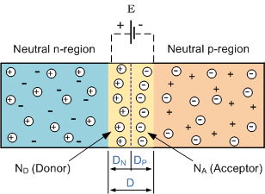
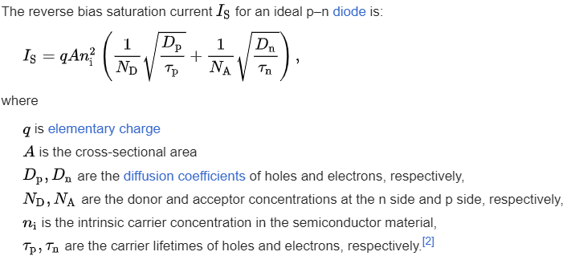
Efficient Solar Panels for Hot Water
21
Prof Robert Kotiuga
Mathematical Modeling - Reverse Saturation Current
Current in reverse of useful direction that is produced by the diffusion of carriers(holes/electrons) to the depletion region
As Ni increases, Is increases

Slide 6
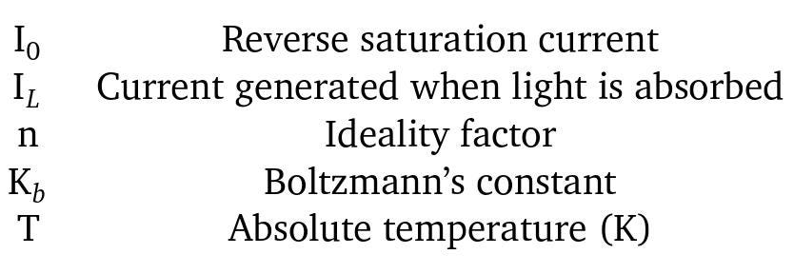
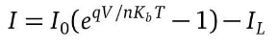
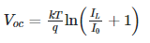
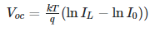
Efficient Solar Panels for Hot Water
21
Prof Robert Kotiuga
Mathematical Modeling - Solar Panel Temperature Dependence
1)Solving for V when I=0 gives us Voc
2)Since IL >> I0, the +1 can be ignored
As T increases, the kT/q increases, but the saturation current (I0) also increases. This means that Voc will increase with temperature until the saturation current becomes significant.

Slide 7
Efficient Solar Panels for Hot Water
21
Prof Robert Kotiuga
Mathematical Modeling - Physical Explanation
Increasing the temperature increases the intrinsic carrier concentration in semiconductors
Higher temperature causes faster diffusion of carriers, meaning more collisions, leading to more recombinations
This means the saturation current increases, which acts like a shunt resistor when the current is high enough (high temperatures) causing the open circuit voltage to decrease

Slide 8
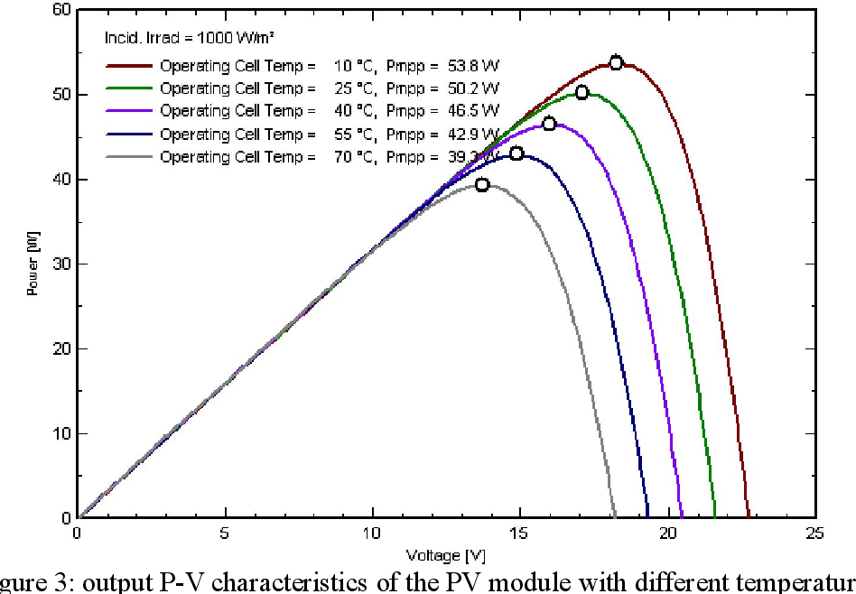
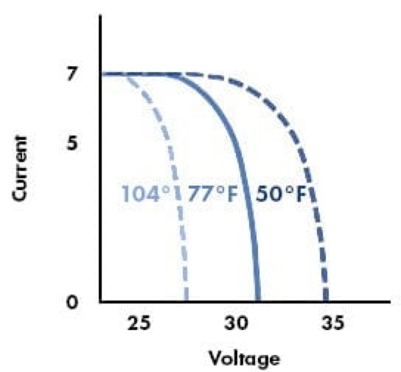
Efficient Solar Panels for Hot Water
21
Prof Robert Kotiuga
Effect of Temperature on Voltage and Current

Slide 9
Efficient Solar Panels for Hot Water
21
Prof Robert Kotiuga
Deliverables
Model energy production against temperature using collected data from our solar panels
→ Determine optimal operating temperature
Build physical system that drives cool water from heat pump to cool the solar panels
Compare and model different designs of this system using data collected on energy use and production by this system

Slide 10
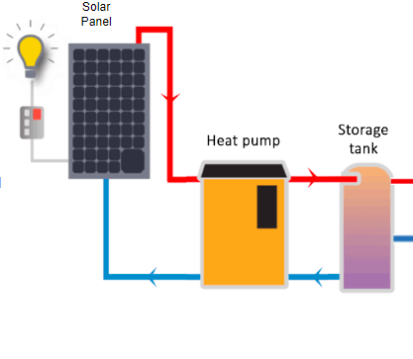
21
Prof Robert Kotiuga
System Diagram
Solar Panel
Home
⚡️
Arduino
Trigger pump
Log temperature and power generation
Web Server to monitor and track metrics
PUMP
Relay
Tank

Slide 11
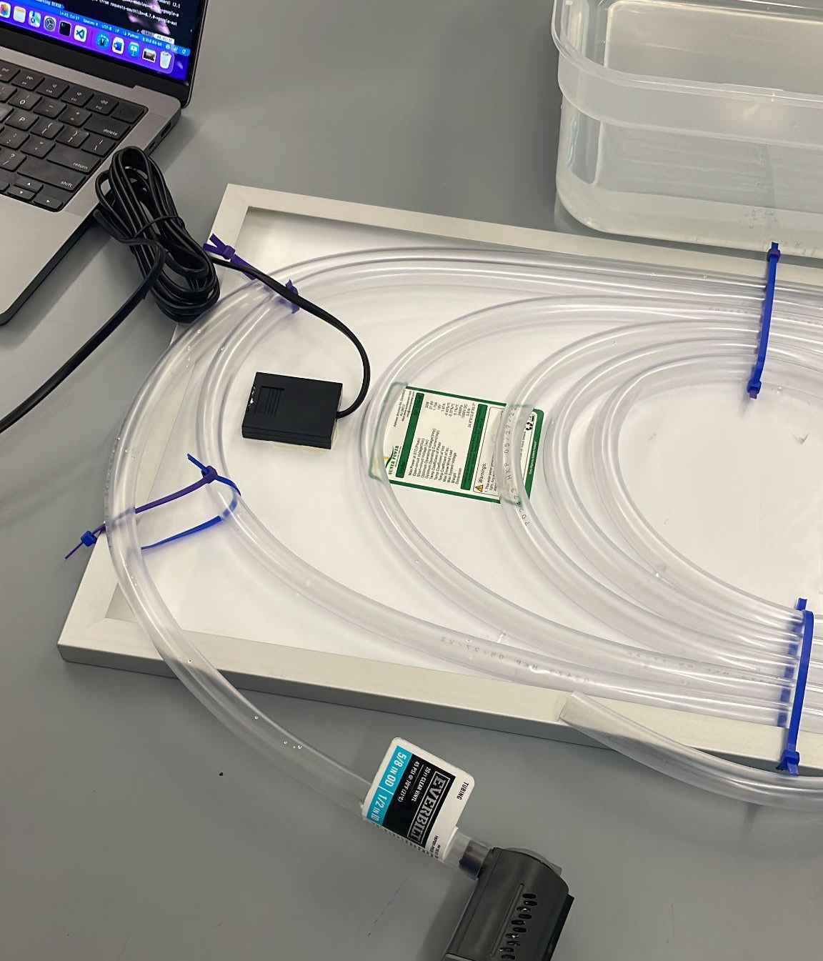
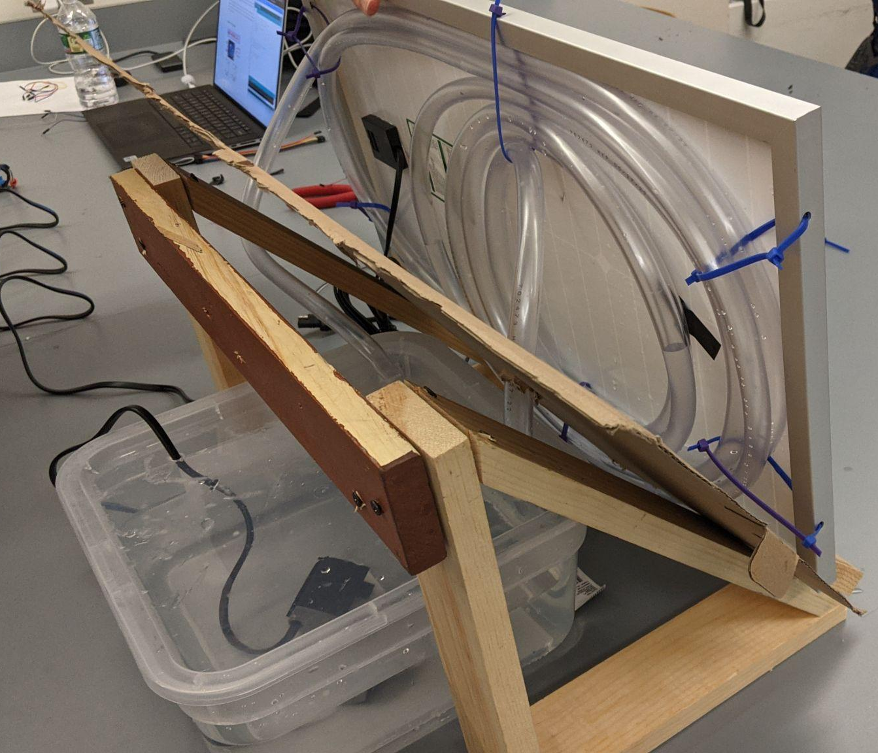
Efficient Solar Panels for Hot Water
21
Prof Robert Kotiuga
Technical Progress - Mechanical System

Slide 12
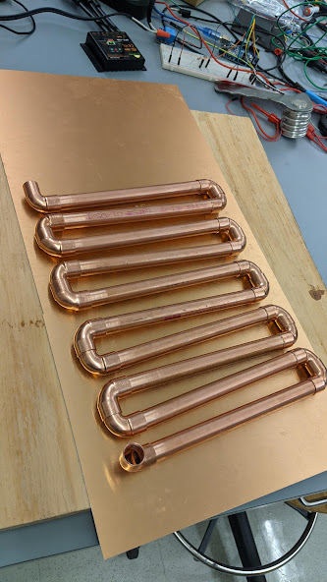
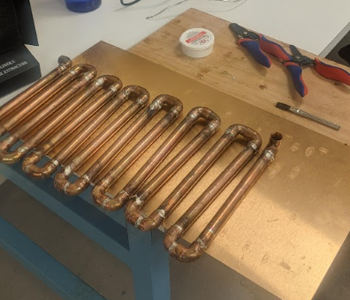
Efficient Solar Panels for Hot Water
21
Prof Robert Kotiuga
Technical Progress - Mechanical System

Slide 13
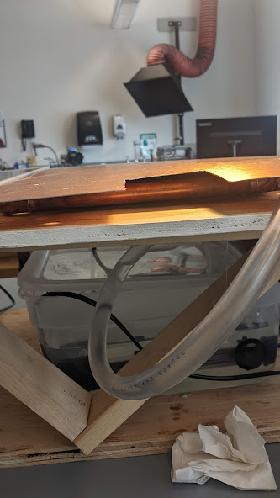
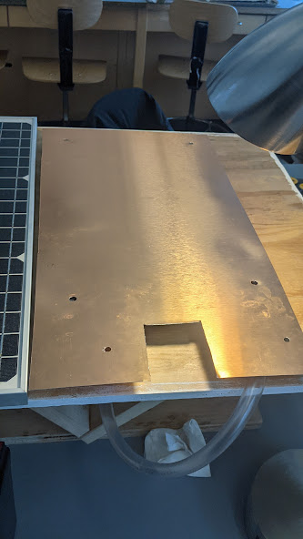
Efficient Solar Panels for Hot Water
21
Prof Robert Kotiuga
Technical Progress - Mechanical System

Slide 14
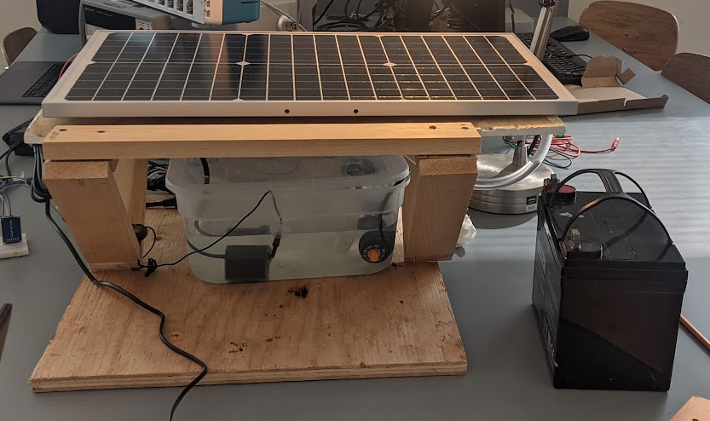
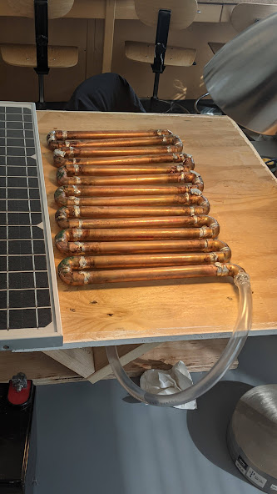
Efficient Solar Panels for Hot Water
21
Prof Robert Kotiuga
Technical Progress - Mechanical System

Slide 15
Efficient Solar Panels for Hot Water
21
Prof Robert Kotiuga
Work Needed for Completion - Electromechanical
Obtain last of needed supplies: 12V Water Pump that is more powerful than our current pump, more accurate temperature sensor
Increase heat transfer from copper pipes to copper sheet metal by soldering better
Improve panel stand and make enclosure for circuitry

Slide 16
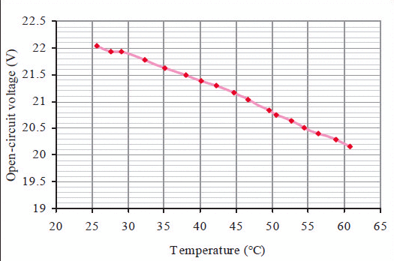
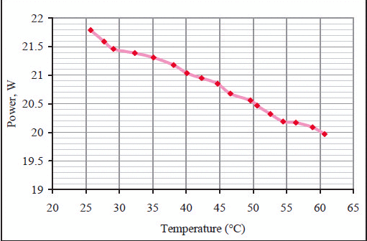
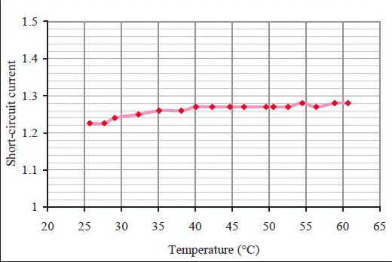
Efficient Solar Panels for Hot Water
21
Prof Robert Kotiuga
Future Data Collection

Slide 17
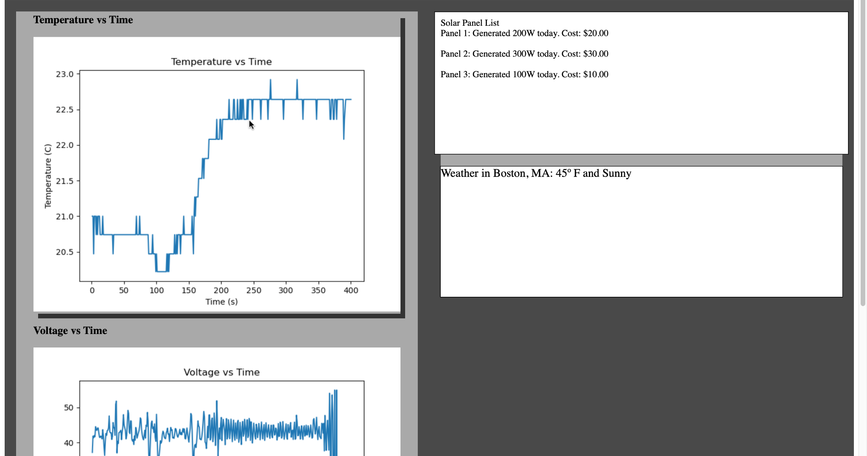
Efficient Solar Panels for Hot Water
21
Prof Robert Kotiuga
Dashboard v1 (MATLAB and Arduino Serial Monitor)
Notes:
Not interactive,

Slide 18
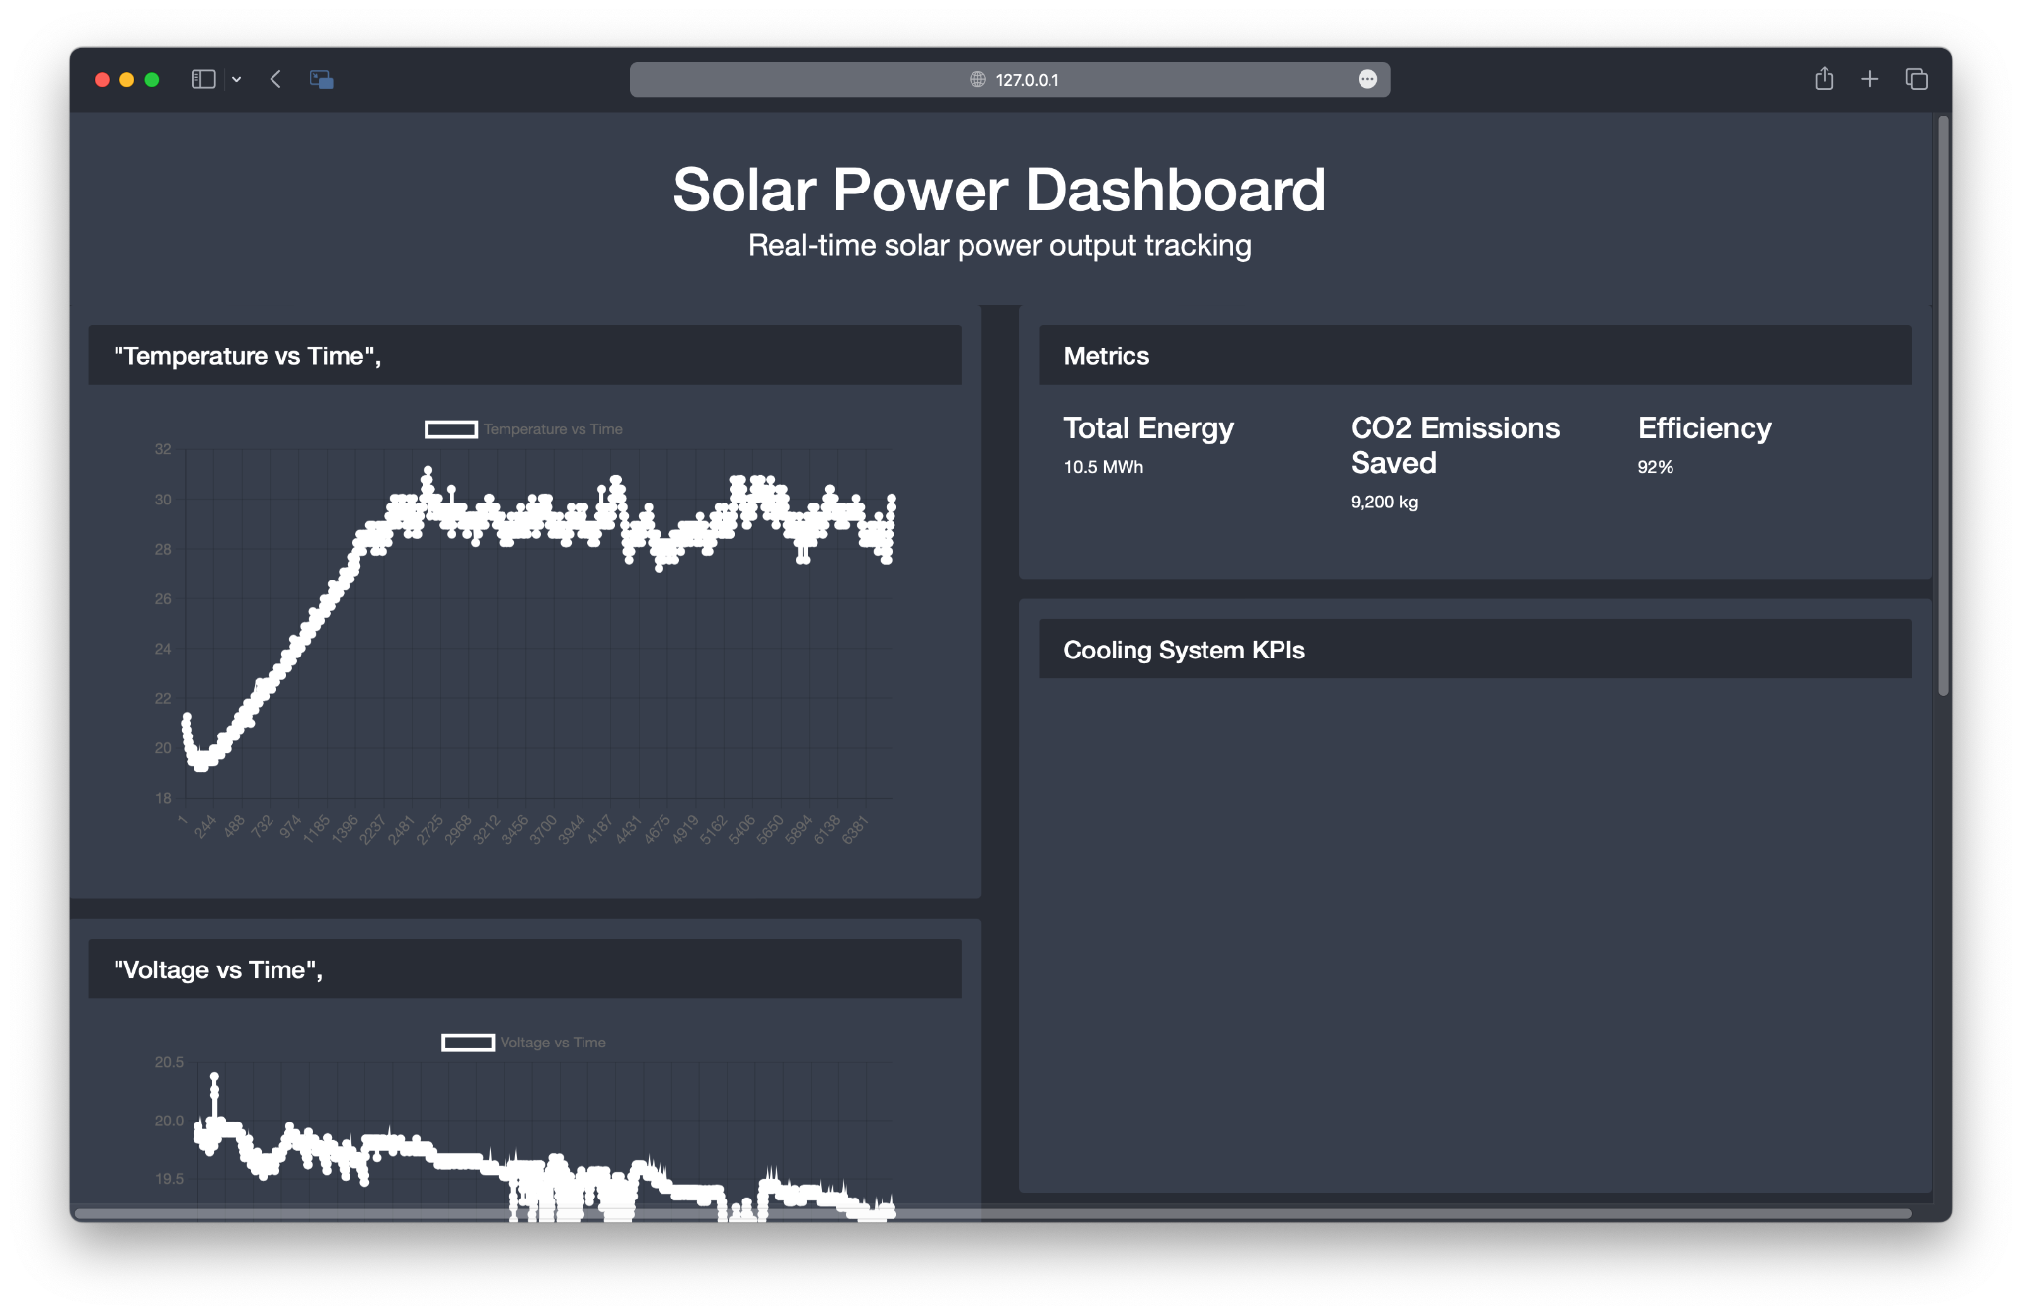
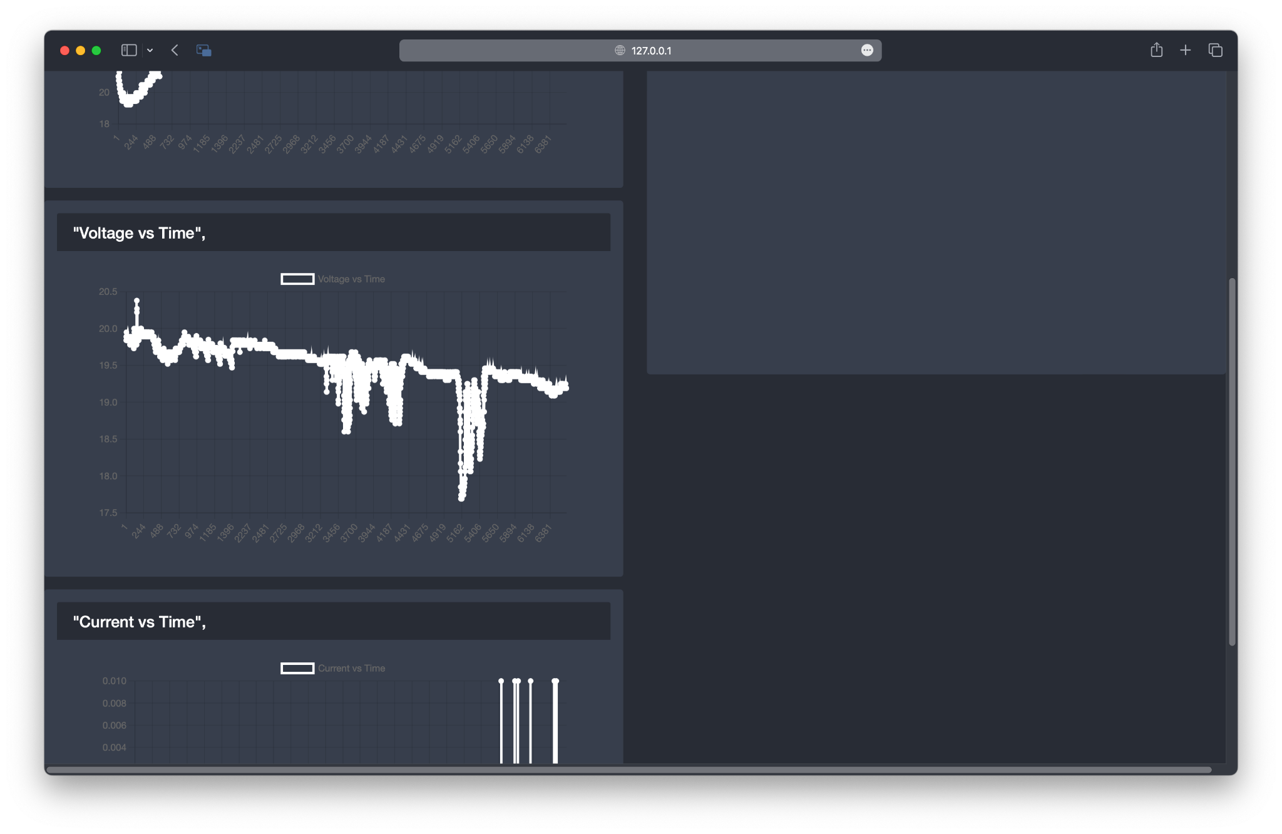
Efficient Solar Panels for Hot Water
21
Prof Robert Kotiuga
Dashboard v2 (Bootstrap and SD Card
Notes:
Left running for 2 hours. Cooling system KPIs will show like amount of power dedicated to heating/cooling system

Slide 19
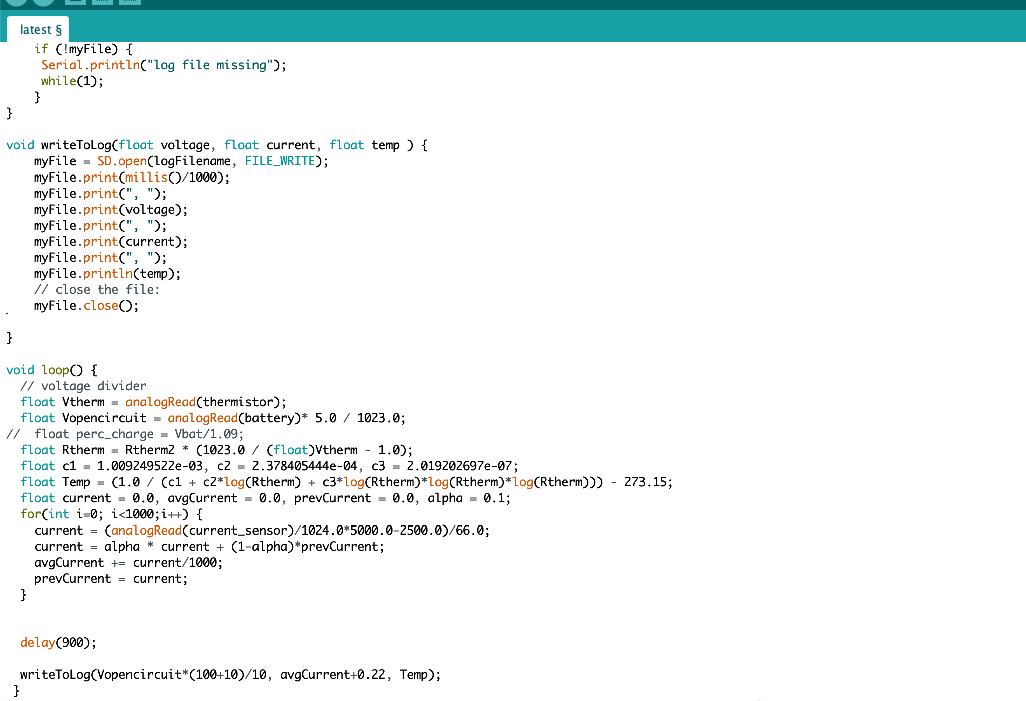
Efficient Solar Panels for Hot Water
21
Prof Robert Kotiuga
Arduino Data Collection

Slide 20
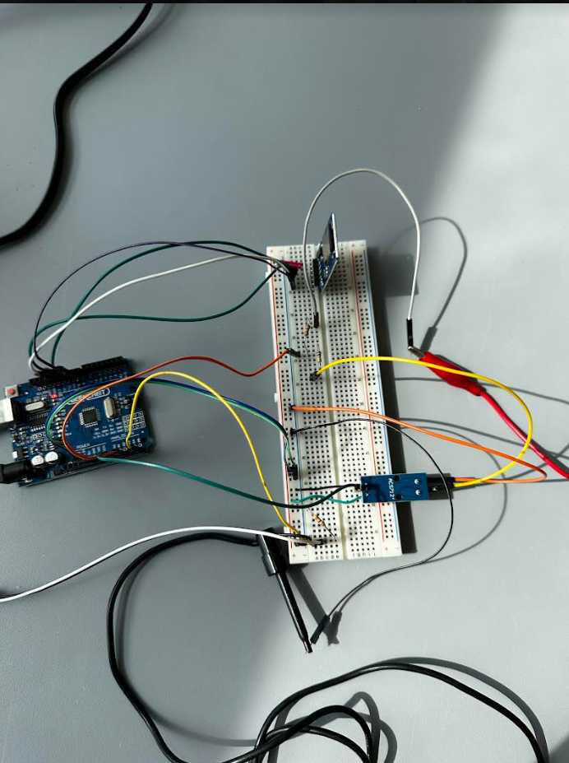
Efficient Solar Panels for Hot Water
21
Prof Robert Kotiuga
Technical Progress - Electrical System
Current Sensor
SD Card Reader
12-24VDC Water Pump
Sensing and logging of voltage is through the current sensor and a voltage divider

Slide 21
Efficient Solar Panels for Hot Water
21
Prof Robert Kotiuga
User Display
Connectivity
Since this is a residential product, we want the device to be easy for end users to manage.
Bluetooth will be impractical for viewing dashboard but could be useful for triggering the pumps. Have one arduino indoors that connects to another Bluetooth (works well if low wifi range on roof)
Wifi or Ethernet (to indoor arduino) would be ideal to connect Arduino and launch web server to view metrics. This would provide internet access: time syncing, weather predictions, live local price of electricity

Slide 22
Efficient Solar Panels for Hot Water
21
Prof Robert Kotiuga
Work Needed for Completion
Display past data collection over time for different temperatures and calculate efficiency over time
Show energy consumption of system and overall energy savings of this system when compared to non-cooled solar panels
Show cost savings over time
Collect data over a large range of temperature (5°C - 32°C)
Find ideal operating temperature to set as threshold for cooling system

Slide 23
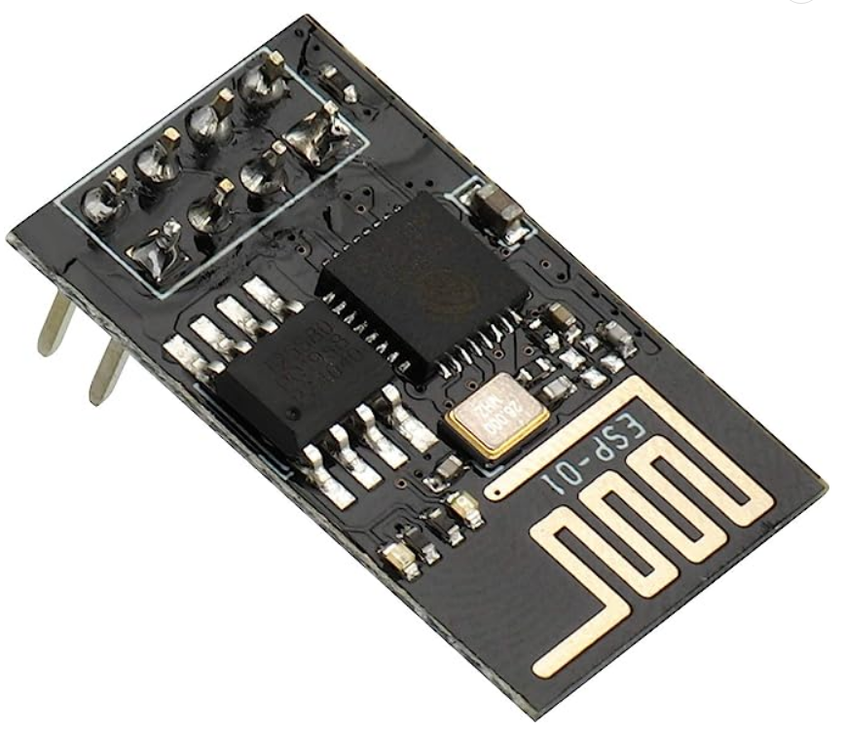
Efficient Solar Panels for Hot Water
21
Prof Robert Kotiuga
ESP8266
WiFi module for internet access
Wireless type: 802.11b
Operative Voltage: 3.3V

Slide 24
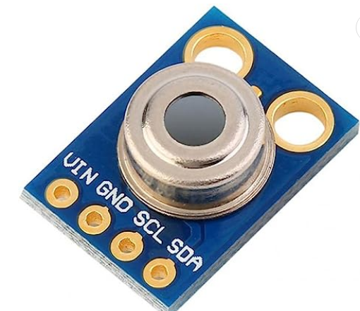
Efficient Solar Panels for Hot Water
21
Prof Robert Kotiuga
IR Temperature Sensor
MLX90614ESF
Voltage: 3.3V - 5V
Temperature Range:
-70℃～382.2℃

Slide 25
Efficient Solar Panels for Hot Water
21
Prof Robert Kotiuga
Reach Goals
Collect data for different times of the day and different light sources
Use heat pump for residential hot water use
Make angle of panel be able to be controlled more easily (to follow angle of sun)

Slide 26
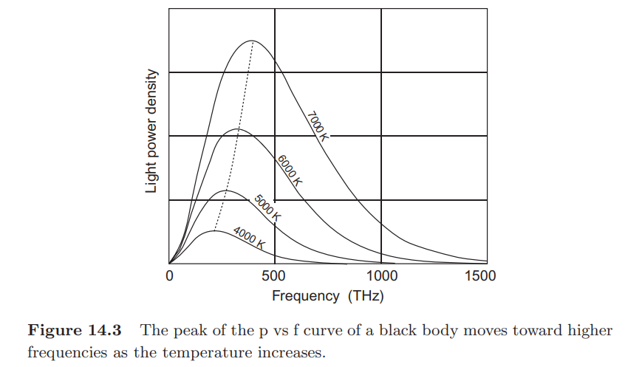
Efficient Solar Panels for Hot Water
21
Prof Robert Kotiuga
Light Source Dependence
Model with sunlight, lamps of different hues

Slide 27
21
Prof Robert Kotiuga
Gantt Chart
Description | 3/16/23 | 3/24/23 | 3/30/23 | 4/6/23 | 4/17/23 | 4/25/23 | 4/28/23 | 5/5/23 | +++
Pipe Welding with copper plates
Install 12VDC water pump
IR Temperature sensor
Ideal temperature for max efficiency
Web Dashboard
Wireless connections for Arduino
Customer Consulting
ECE Day Preparation

Slide 28
21
Prof Robert Kotiuga
Thank you
Questions/Comments

